Slide 1
Attrition Intelligence Dashboard
Full cycle analysis from hiring to resignation | Power BI
Presented by :
Bimal Kumar Saini

Slide 2
An HR department want to understand an employee’s full journey to reduce attrition and improve talent retention and manager effectiveness.
High risk attrition combination.
Top variables affect attrition and age relation with them.
Performance of employee by job involvement and training time.
Demographic group by department wise income.
Promotion by current pay, job level and high tenure employees.
Work life Balance by department and overtime.

Slide 3
Our Solutions
High attrition combinations
Provide them less travel and no force to overtime.
Top reasons to leave
Provide them better job and environment score, improve in promotion, pay fairly and control in overtime hours. Need to treat better with middle age employee.
Performance by job involvement and training
Focus on the quality of training not the time.
Salary differences by demographic group
Reduce unfair income and salary hike by demographic group.
Promotion by current pay, job level and high tenure employees.
Provide better promotion for good performer employee.
Work life Balance by department and overtime.
Reduce unfair income and salary hike by demographic group.

Slide 4
Approach and Methodolgy
Data collection – Attrition Intelligence worksheet
Data cleaning – Analyze the data types, find nulls if any, use feature engineering and create columns brackets of age, working years and promotion, combine demographic group, employee leaving chance.
Exploratory data analysis – create hierarchical dropdown, analyze attrition over age, income, demographic group, different score, work life balance, create data analysis expression like attrition rate, department wise income, share of high tenure.
Key variables – some influential factors are job level, overtime, job and environment satisfaction score, promotion, income

Slide 5
Key Findings
Attrition factors
Sales department – For job level 1 attrition rate is 42 and overall 105 attrition rate.
Overtime and frequently travel – Attrition rate of 42.
Job and environment satisfaction score – High attrition risk for (<=2).
Income – Employee income (< department and job role wise) has high attrition risk.
Demographic group
Middle age group (30-45) has high attrition.
Single-Female has lowest income.
Promotions
Job level 5 has highest promotion of 5.56 years.
Work life balance score
For score 1 has high attrition rate of 31.25.

Slide 6
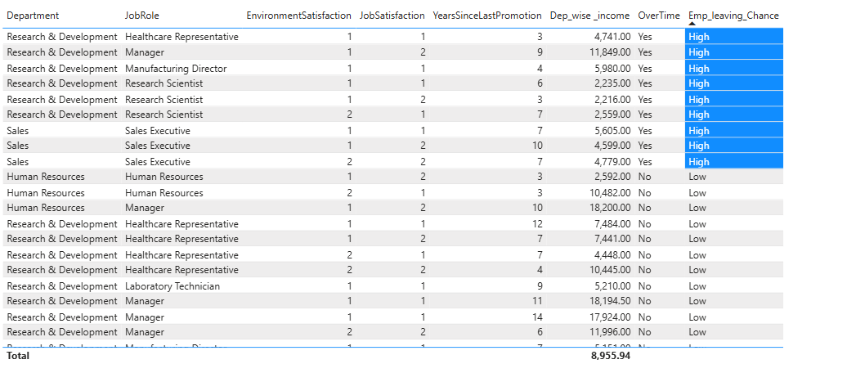
Visuals and insights
1.29 % of total employees could have high chance to leave company.

Slide 7
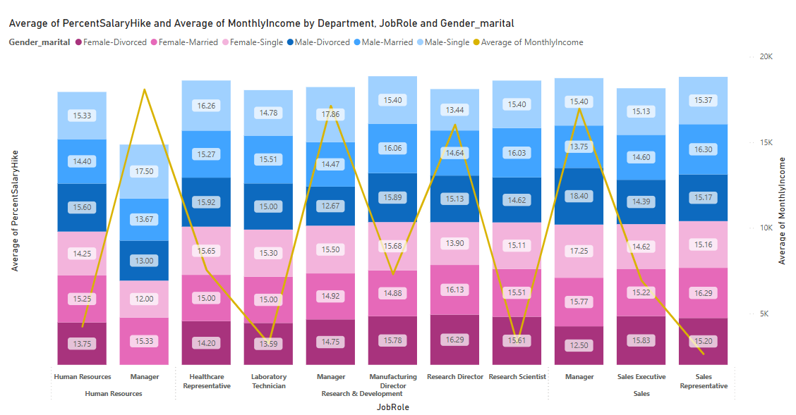
Visuals and insights
Single-Female has low salary hike of 12% and Male-Divorced has highest salary hike of 18%.

Slide 8
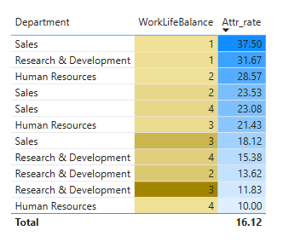
Visuals and insights
For poor work life balance , Sales department has highest attrition rate of 37.50.

Slide 9
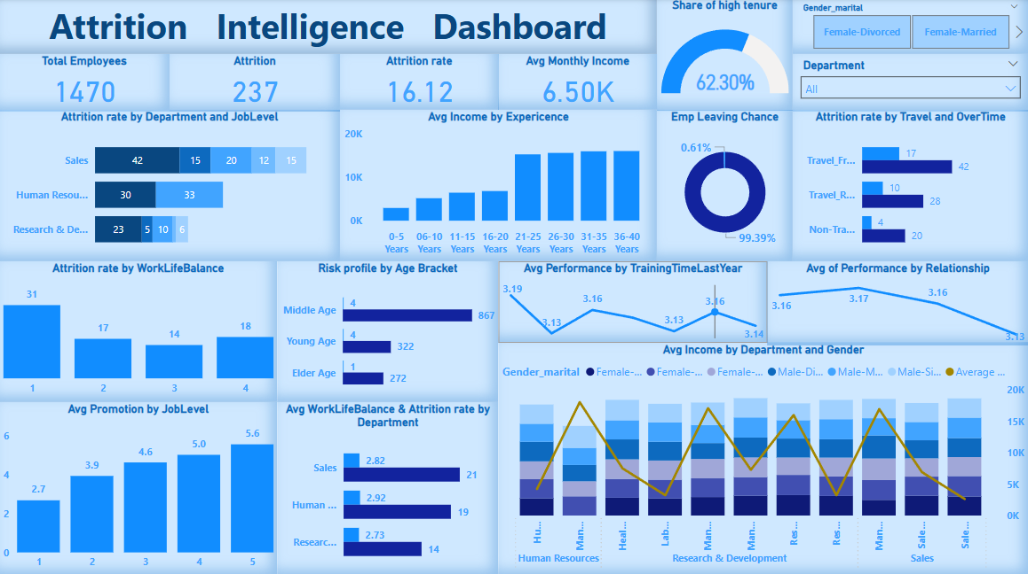
DashBoard Visual

Slide 10
Recommendations
Decrease overtime for employee who is in travel frequently category.
Improve job and environment satisfaction score.
Improve work life balance score.
Improve income whose performance is high in job level 1.
Promote employee whose performance score is better.
Treat equally with gender demographic.
Organize motivate sessions.
Organize teamwork events or projects and provide rewards.

Slide 11
Conclusion
We can predict attrition early by analyzing job role and level, different satisfaction score, income, overtime.
Some employee is at high risk having promotion pending from many years, poor work life balance.
This Dashboard helps HR to reduce attrition rate and tells who can leave the company.

Slide 12
Any Query ?

Slide 13
Thank You !!!

